Slide 2
Tour and Travel Booking System
Submitted to:
Department of Information Technology

Slide 3
Supervised by: Prof. Brajesh Chaturvedi
Team Members
1.Anuj Mishra
2.Harsh Machiya
3.Chirag Malviya

Slide 4
Project Presentation Outline
Abstract
Introduction
Problem Statement
Survey of Existing Systems
Project Objectives
Requirement Analysis
Solution Proposed
The Outcome Discussion
Conclusions and Limitations

Slide 5
Abstract
This is a tour and travel booking system project is a software Website designed to streamline the process of planning and booking trips and vacations. It enables travelers to search for destinations, compare prices, view itineraries, and make reservations for flights, accommodations, transportation, and activities all in one convenient platform. Additionally, it often includes features such as user profiles, payment processing, and real-time availability updates to ensure a seamless and hassle-free travel booking experience for both customers and travel providers.

Slide 6
Introduction
Information Overload: Travelers can be overwhelmed by the abundance of information available online. Our website should provide curated, reliable, and up-to-date information on destinations, activities, and accommodations. User-generated reviews and ratings can help build trust.
Language Barriers: Language differences can be a significant hurdle. Incorporate translation features or offer multilingual content to help tourists navigate foreign destinations.
Hidden Costs: Unexpected expenses can sour a trip. Clearly list all costs, including fees, taxes, and optional extras, during the booking process. Provide budgeting tools and cost breakdowns to help travelers plan their expenses.
Safety Concerns: Safety is a top priority for tourists. Include safety tips, local emergency contact information, and a platform for reporting incidents or seeking assistance. Real-time safety updates for specific destinations can also be valuable.
Last-Minute Changes: Travel plans can change unexpectedly. Provide flexible booking and cancellation policies, as well as a mobile app for on-the-go adjustments to reservations and itineraries.
Cultural Sensitivity: Travelers may not be familiar with local customs and etiquette. Include cultural guides and tips for respectful behavior in different regions.
Accessibility: Some tourists may have special needs or disabilities. Ensure that your website complies with accessibility standards and offers information on accessible accommodations, transportation, and attractions.

Slide 7
Introduction
Community and Social Interaction: Facilitate a sense of community among travelers. Incorporate social features like forums, travel blogs, and discussion boards where users can share their experiences, ask questions, and offer advice.
Emergency Support: Offer a 24/7 customer support service for emergencies or unexpected issues while traveling. Include a dedicated section for travelers to access emergency contact information, both for your platform and for local authorities.
By addressing these common problems and providing solutions on your tour and travel website, you can create a user-friendly, trustworthy, and valuable resource that enhances the overall travel experience for tourists.

Slide 8






Technologies Are Used

Slide 9
The Problem Statement
Inefficient Booking Process: Travelers struggle with a complex and time-consuming booking process for flights, accommodations, and activities, leading to frustration and a poor user experience.
Lack of Comprehensive Travel Information: Travelers find it challenging to access up-to-date and comprehensive information about destinations, including attractions, accommodations, and local events.
Limited Access to Local Experiences: Tourists miss out on authentic local experiences due to a lack of access to local guides, tours, and cultural activities.
Safety and Security Concerns: Travelers express concerns about safety and security while traveling, including travel advisories, emergency support, and risk mitigation.
Hidden Fees and Unexpected Costs: Travelers encounter hidden fees and unexpected costs when booking, leading to budget overruns and dissatisfaction.

Slide 10
Survey of Existing Systems
Booking.com
Characteristics:
Extensive database of accommodations worldwide.
User-friendly interface with advanced search filters.
Real-time availability and pricing information.
Advantages:
Wide selection of hotels, hostels, and vacation rentals.
User reviews and ratings for informed decisions.
Booking flexibility and free cancellation options.
Disadvantages:
High commission fees for property owners.
Frequent changes in pricing due to demand.

Slide 11
Survey of Existing Systems
TripAdvisor
Characteristics:
User-generated reviews and ratings for hotels, restaurants, and attractions.
Travel forums for advice and discussion.
Booking options for accommodations and activities.
Advantages:
Vast amount of traveler-generated content.
Insights from real experiences for informed choices.
Integration of booking options for convenience.
Disadvantages:
Quality and authenticity of reviews may vary.
Booking options might not always offer the best prices.

Slide 12
Survey of Existing Systems
Lonely Planet
Characteristics:
Travel guides and resources for various destinations.
Inspirational travel content, including articles and books.
Online community and travel forum.
Advantages:
In-depth destination information and travel tips.
Insightful cultural and historical context.
A sense of community among like-minded travelers.
Disadvantages:
Booking options are limited.
May not offer real-time pricing or availability

Slide 13
Objectives
Customer Satisfaction: Prioritize delivering exceptional travel experiences that meet or exceed customer expectations to build a positive reputation and foster loyalty.
Profitability: Aim to generate revenue through bookings and other income streams to ensure the project's sustainability and growth.
Ease of Booking: Offer a user-friendly platform that simplifies the booking process, making it easy for travelers to plan and book their trips.
Safety and Security: Ensure the safety and security of travelers by providing accurate information, adhering to safety regulations, and offering travel insurance options.
Continuous Improvement: Continuously assess and improve services based on customer feedback and market trends, adapting to changing customer preferences and emerging technologies.

Slide 14
Requirement Analysis
User Requirements:
Define user profiles and preferences.
Understand traveler goals and needs.
Identify services required by travel agencies.
Define service provider roles and responsibilities.
Functional Requirements: 5. Specify booking system processes (search, selection, reservation, payment).
Define user account management (registration, login, profiles).
Outline content management for travel listings.
Specify payment and billing processes.
Define search and filtering options.
Include reviews and ratings system.

Slide 15
Requirement Analysis
Specify notifications and alerts.
Define admin dashboard for platform management.
Non-Functional Requirements:
Address performance and scalability requirements.
Ensure data security and privacy measures.
Plan for mobile responsiveness.
Define backup and recovery procedures.
Ensure compliance with industry regulations.
Address integration requirements with third-party services.

Slide 16
Solution Proposed
To create a successful tour and travel website, focus on user-friendly design, destination information, booking capabilities, informative travel content, user reviews, mobile responsiveness, interactive maps, multilingual support, and secure payment options. Promote travel deals, integrate social media, offer customer support, provide travel insurance information, enable newsletter subscriptions, and implement search filters. Collaborate with local partners, utilize analytics, and include legal and safety information. Regularly update content and employ effective marketing strategies to attract and engage visitors in the competitive travel industry.

Slide 17
The Outcome Discussion
The project development for a tour and travel website aims to deliver a fully functional, user-friendly platform with comprehensive destination content, an efficient booking system, interactive features, robust security, mobile responsiveness, effective marketing, user feedback mechanisms, analytics integration, legal compliance, partnerships with local businesses, customer support, SEO optimization, conversion tracking, and a commitment to regular updates to ensure a competitive and engaging user experience.

Slide 18
Conclusion and Limitation
Conclusion:
A tour and travel website can be a valuable resource for travelers.
It offers comprehensive destination information and a seamless booking experience.
Engagement opportunities with users enhance its value.
Effective planning is essential for success.
Limitations:
Budget constraints can impact the project's scope.
Technical challenges may arise during development and require ongoing maintenance.
Adherence to evolving industry regulations is necessary.
Vigilance in data security is vital.
Intense competition requires effective marketing strategies for visibility.
Continuous adaptation and commitment to user satisfaction are crucial for success.

Slide 19
Acknowledgment
We are pleased to acknowledgment our sincere thanks to board of Management of Acropolis Institute of Technology and Research for their kind encouragement in doing this project and for completing it successfully. We could convey our thanks to Prof. Nivedita Tiwari (Minor project Head) and prof. Dr. Prashant Lakkadwala (HOD of IT department) for providing us with necessary support and details at the right time. We would like to express out sincere and deep sense of gratitude to our project Guide prof. Brajesh Chaturvedi for his valuable guidance, suggestions and constant encouragement paved way for the successful completion of my project work. We wish to express our thanks to all teaching and non-teaching staff members of the department o f Information technology who were helpful in many ways for the completion of this project.

Slide 20
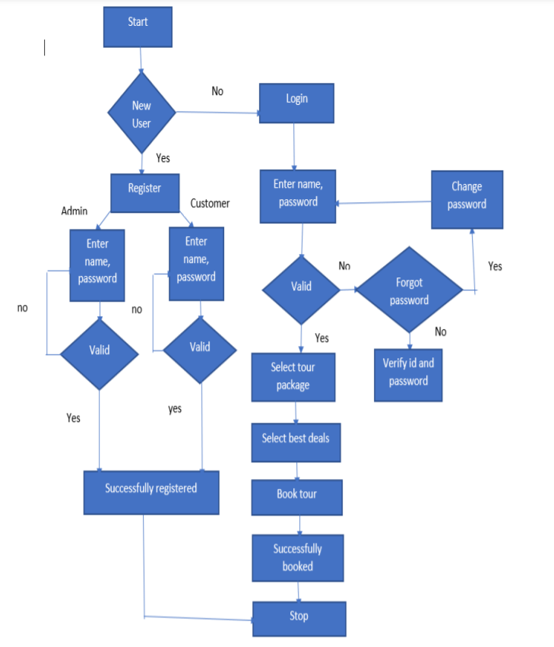
Block Diagram

Slide 21
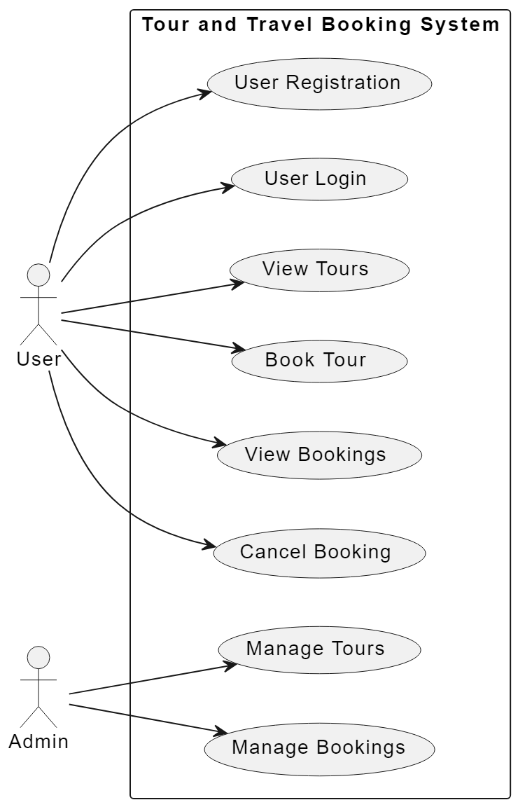
Use Case Diagram

Slide 22
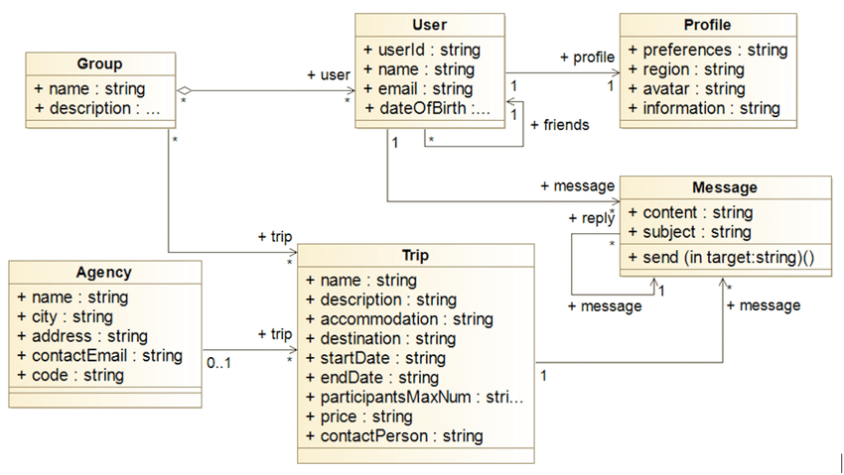
Class Diagram

Slide 23
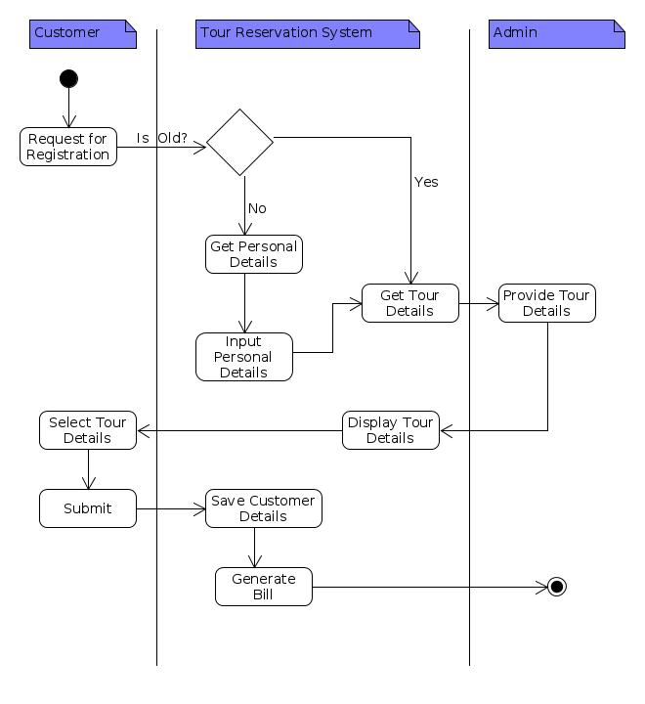
Activity Diagram

Slide 24
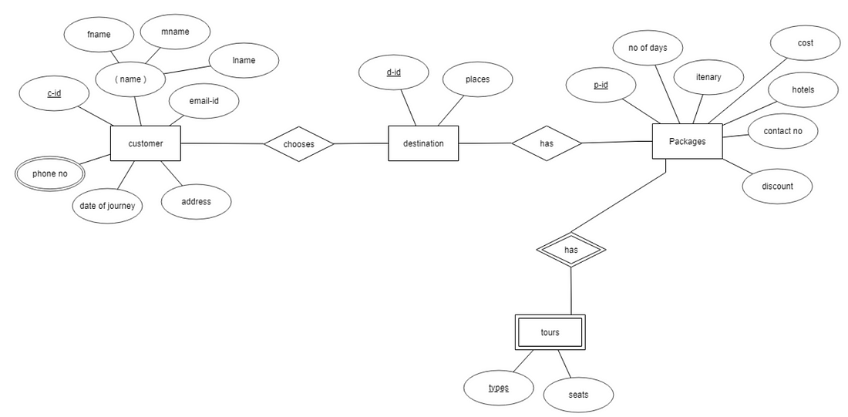
E-R Diagram

Slide 25
THANKS

